Slide 1
Object Oriented Analysis and Design CSCI-5440 Elizabeth Boese
Project : Shopping Cart
Shravan Shetty
shravan.shetty@colorado.edu

Slide 2
Shopping Cart
Name: Shravan Shetty
GitHub link:​ https://github.com/shsh9888/shoppingcart
Technologies :
Spring boot
Java
MVC
Hibernate
Thymeleaf

Slide 3
Design Patterns
Data Access Object (DAO)
Use : Separate layer for all Db operations
Strategy Pattern
Process payment for an order with either Visa/Mastercard
Factory Pattern
Custom logger with of types Info, Debug and Error.

Slide 4
DAO Pattern
Isolate the Application layer from the persistence layer.
Hides all the complexities involved in performing CRUD operations in underlying storage mechanism.
Let both layers evolve on separately without knowing anything about each other.
It implements open for extension and closed for modification principle.
Let’s there is an use case where we have to change the DB from MYSQL to MONGO tomorrow. This change would be simpler with Dao as that’s the only layer which will change. Application layer remains unchanged.

Slide 5
DAO Pattern Implementation
Data Access Object Interface : Standard operations to be performed on the model object/Entity.
E.g. : UserDaoInterface, OrderDaoInterface
Data Access Object: Implements the above interface and responsible for DB operations
E.g. : UserDao, OrderDao
Model Object/Entity : POJO class representing a table in the DB. Consists of getters and setters.

Slide 6
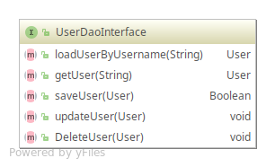
How did I implement? DAO Interface - UserDaoInterface

Slide 7
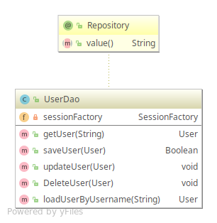
How did I implement? Data Access Object – UserDao

Slide 8
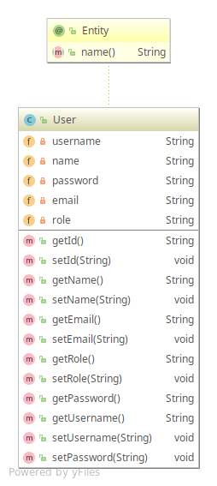
How did I implement? Model Object – User

Slide 9
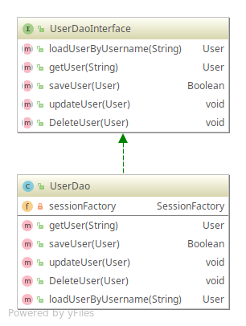
How did I implement? Dao Pattern - Complete

Slide 10
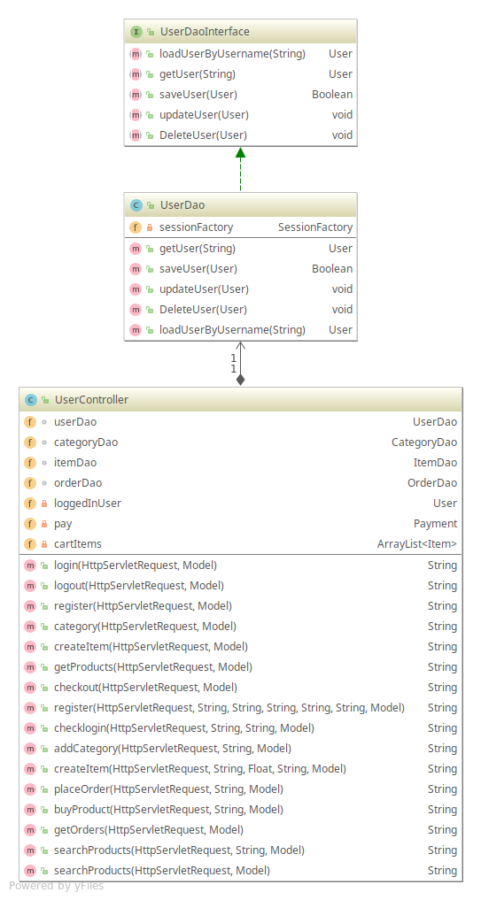
How did I implement? Dao Pattern - Usage

Slide 11
Thank you

